Slide 1
Theorem 7
for every NFA, there is some FA that accepts exactly the same language.

Slide 2
Theorem 7
for every NFA, there is some FA that accepts exactly the same language.
Proof 1

Slide 3

NFA to FA
Build an FA corresponding to the following NFA which accepts the language of strings containing bb

Slide 4
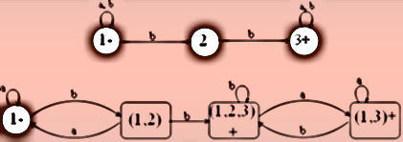
NFA to FA cont.

Slide 5

Example continued …
Old states | New states after reading
 | a | b
Z₁ _ ≡ x₁ | x₁ ≡ z₁ | (x₁, x₂) ≡ z₂
z₂ ≡ (x₁, x₂) | (x₁, Λ) ≡ x₁ ≡ z₁ | (x₁, x₂, x₃) ≡ z₃
z₃ + ≡ (x₁, x₂, x₃) | (x₁,x₃) ≡ z₄ | (x₁ ,x₂,x₃) ≡ z₃
z₄+ ≡ (x₁,x₃) | (x₁,x₃) ≡ z₄ | (x₁ ,x₂,x₃) ≡ z₃
The corresponding transition diagram follows as

Slide 6

Example continued …

Slide 7
Alg - RegExp to DFA via GenNFA
Given a RegExp: ab+ac+ad+ae+af
Construct a simple GenNFA with two states with one arc between the two states labeled with the regular expression.
The source of the arc is the start state
The target of the arc is the final state

Slide 8
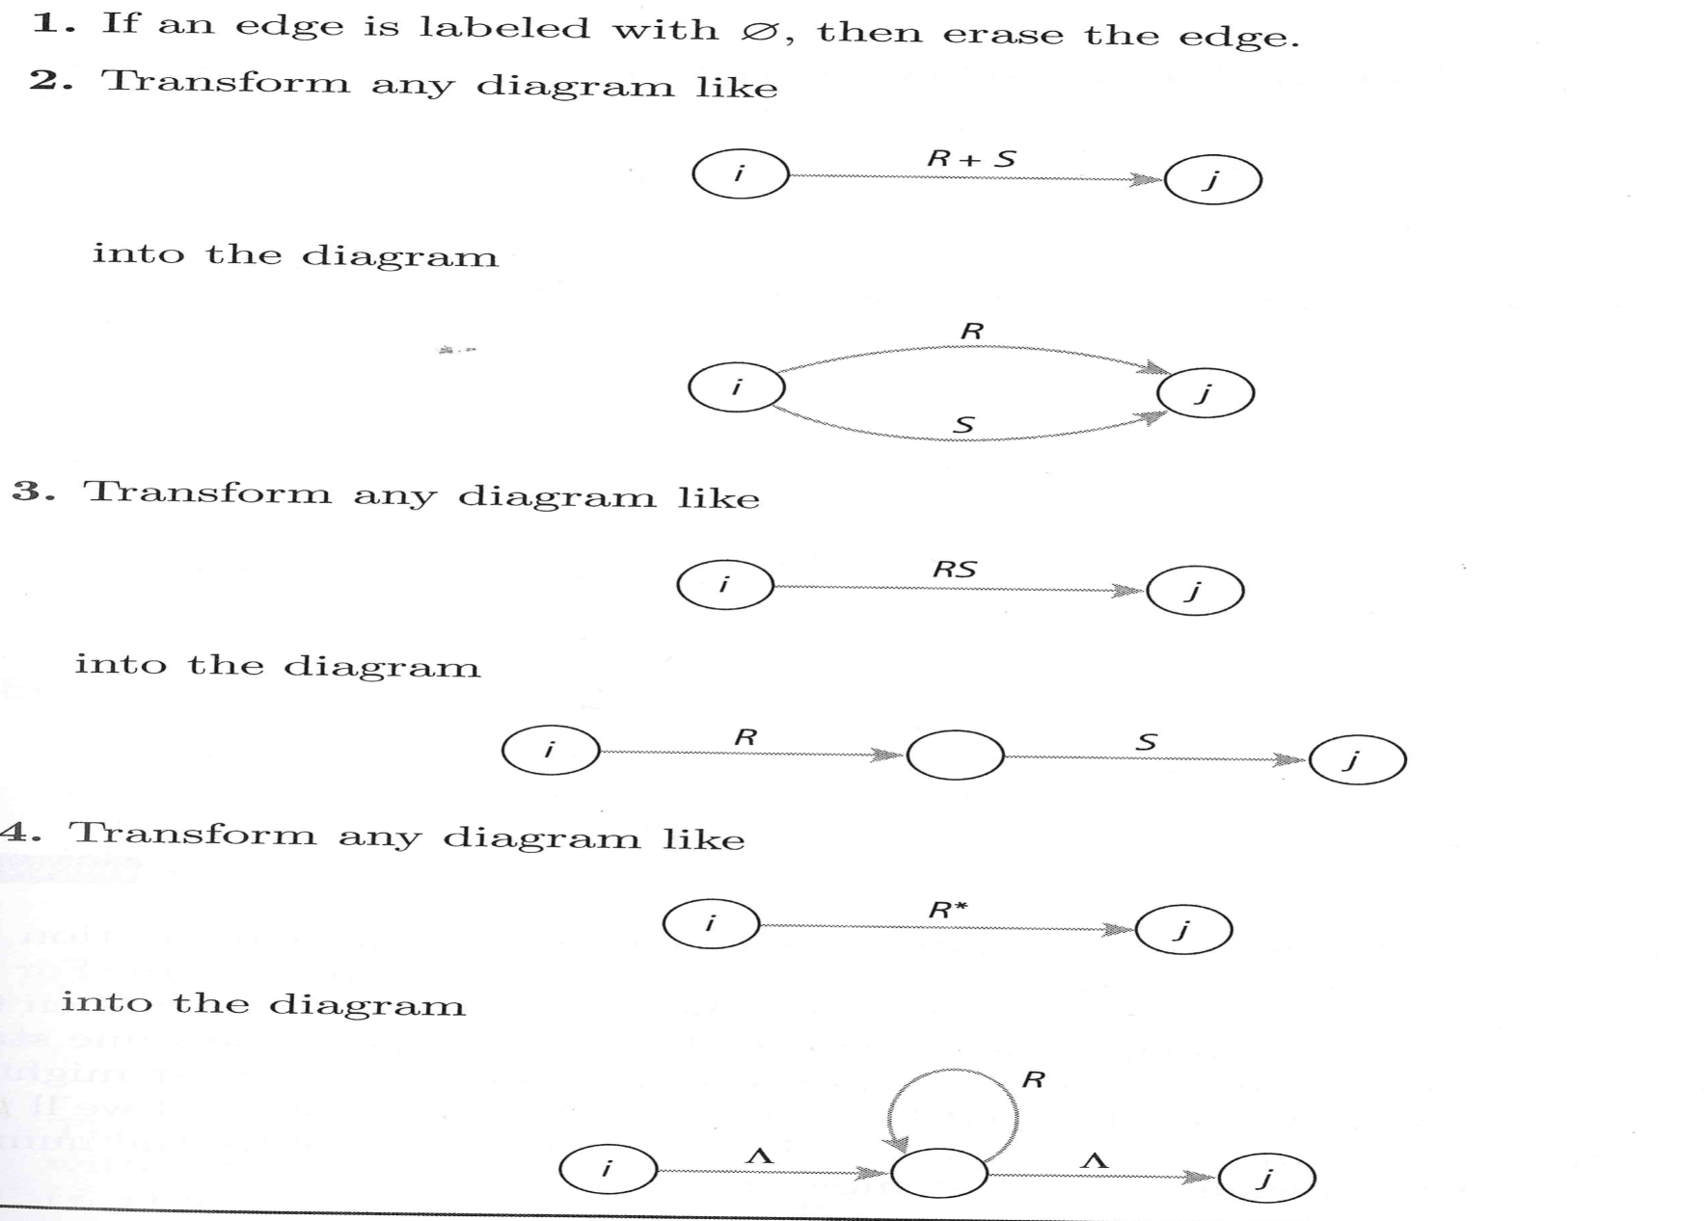
Extend the GenNFA

Slide 9
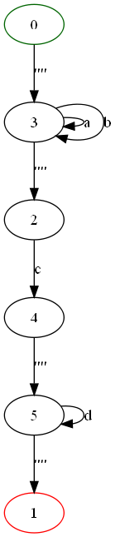
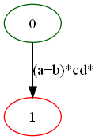

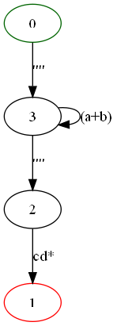
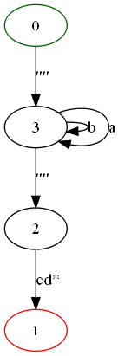
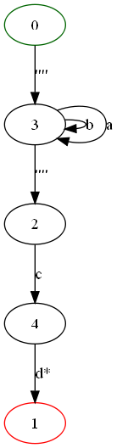
(a+b)*cd*

